Slide 1
FBI WARNING
People under 18 ages are
not admitted.

Slide 2





PUBG Finish Placement Prediction
Let's let the data do the talking!
What's the best strategy to win in PUBG?

Slide 3

CONTENTS
Data Description
Model Building and Selection
LS
Lasso, Ridge, PCA
SVM, Neural Network
KNN, Regression Learner (MATLAB)
Model Comparison

Slide 4
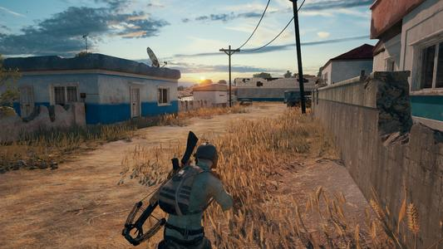
Data Description

Slide 5

Data Resource
Data Description

Slide 6
Data Processing and Analysis
winPlacePerc
boosts | damageDealt | heals | killPlace | kills | killStreaks | headshotKills
maxPlace | numGroups | roadKills | vehicleDestroys | walkDistance | weaponsAcquired | swinDistance

Slide 7
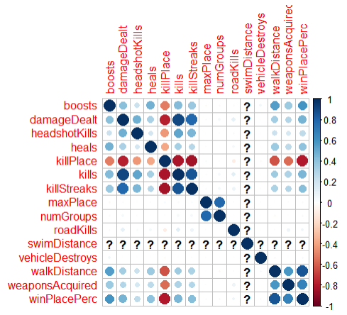
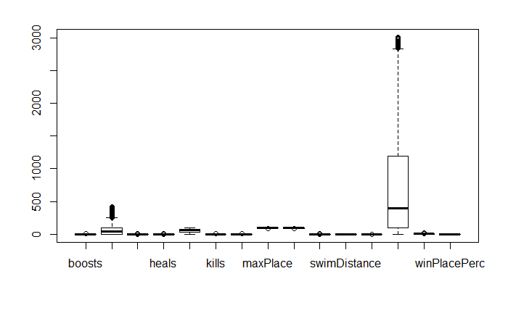
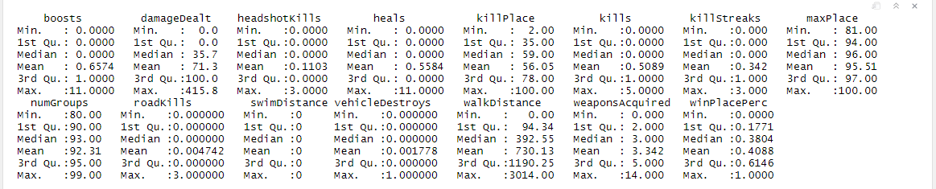
Data Processing and Analysis
summary()
boxplot()
cor(), corrplot()

Slide 8
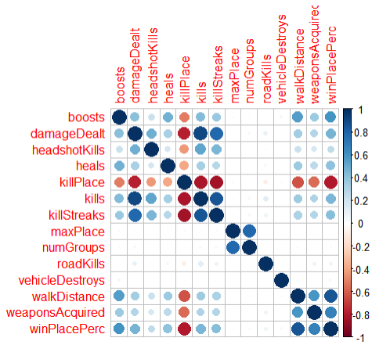
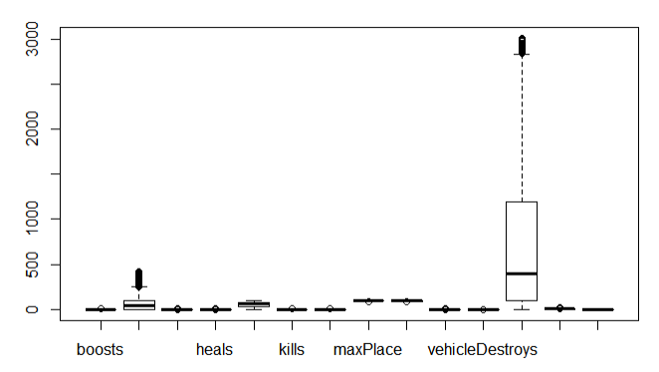
Data Processing and Analysis
boxplot()
cor(), corrplot()

Slide 9
LS
Lasso, Ridge, PCA
SVM, Neural Network
KNN, Regression Learner (MATLAB)
Model Building and Selection

Slide 10
Model Building and Selection L S

Slide 11
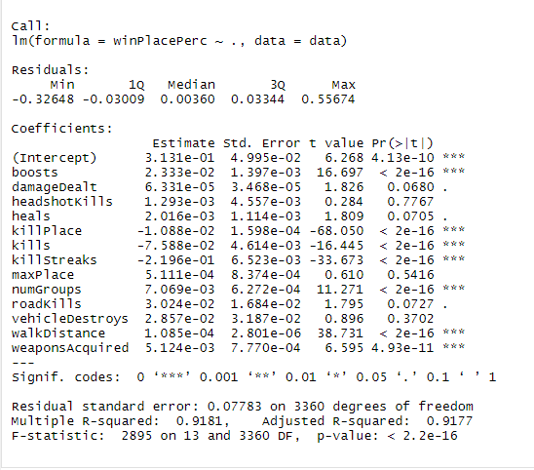
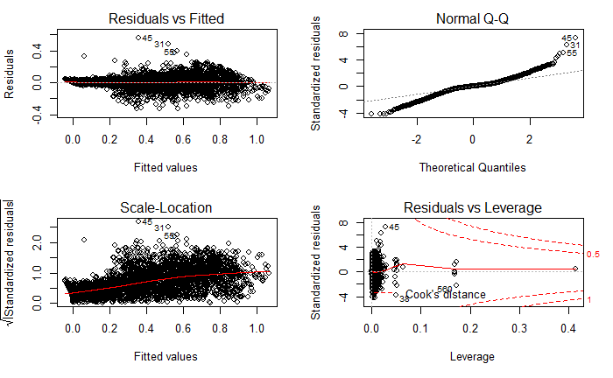
LM: Fit All Variables——lm.fit1
lm.fit1 = lm(winPlacePerc~.)
summary()
plot()

Slide 12
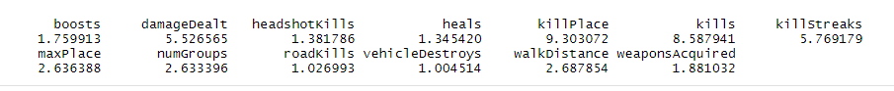
LM: Fit All Variables——lm.fit1
lm.fit1 = lm(winPlacePerc~.)
R-squared: 0.9181 Adjusted R-squared: 0.9177
vif()

Slide 13
LM: Delete Muticollinearity——lm.fit2
lm.fit2 = lm(winPlacePerc~. – killPlace - kills)
R-squared: 0.8049 Adjusted R-squared: 0.8043
vif()

Slide 14
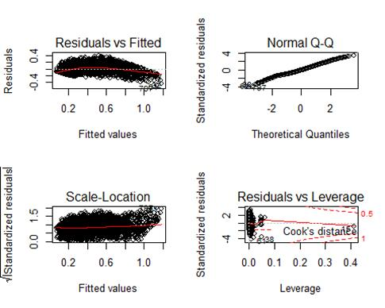
LM: stepAIC(lm.fit2)——lm.fit3
lm.fit3 = lm(winPlacePerc ~ boosts + damageDealt + heals + killStreaks +
maxPlace + numGroups + roadKills + walkDistance + weaponsAcquired)
R-squared: 0.8048 Adjusted R-squared: 0.8043

Slide 15
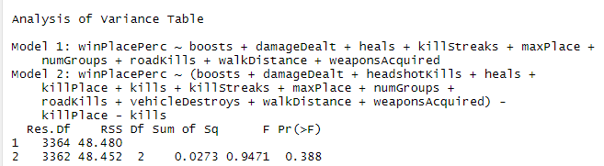
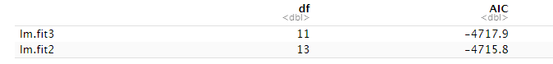
Compare lm.fit2 and lm.fit3
anova(lm.fit3, lm.fit2)
AIC(lm.fit3, lm.fit2)

Slide 16
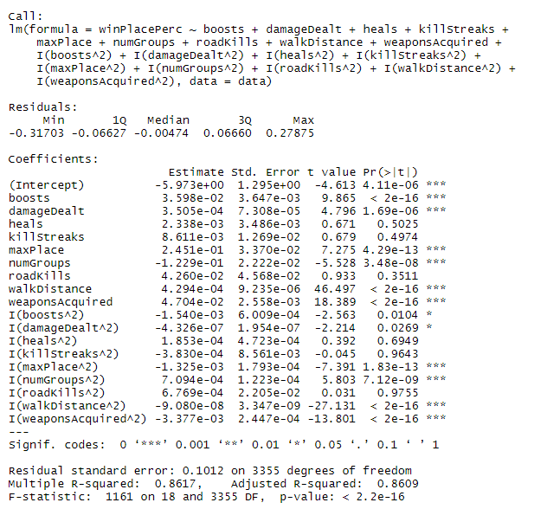
LM: Add Quadratic Forms ——lm.fit4
lm.fit4 = lm(winPlacePerc~boosts + damageDealt + heals + killStreaks + maxPlace + numGroups + roadKills + walkDistance + weaponsAcquired + I(boosts^2) + I(damageDealt^2) + I(heals^2) + I(killStreaks^2) + I(maxPlace^2) + I(numGroups^2) + I(roadKills^2) + I(walkDistance^2) + I(weaponsAcquired^2))

Slide 17
stepAIC(lm.fit4)
lm.fit5
lm.fit4
regsubset(lm.fit4)
lm.fit6

Slide 18
LM: stepAIC(lm.fit4)——lm.fit5
lm.fit5 = lm(winPlacePerc~boosts + damageDealt + heals + maxPlace + numGroups + roadKills + walkDistance + weaponsAcquired + I(boosts^2) + I(damageDealt^2) + I(maxPlace^2) + I(numGroups^2) + I(walkDistance^2) + I(weaponsAcquired^2))
R-squared: Adjusted R-squared:
0.862 0.861

Slide 19
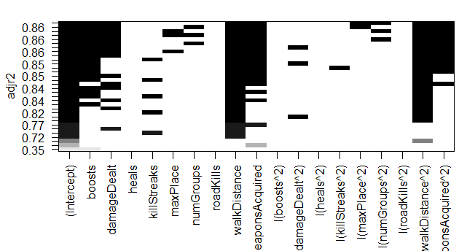
LM: All Subset Method——lm.fit6
lm.fit6=lm(winPlacePerc ~ boosts + damageDealt + walkDistance + weaponsAcquired + I(maxPlace^2) + I(numGroups^2) + I(walkDistance^2) + I(weaponsAcquired^2))
R-squared: Adjusted R-squared:
0.858 0.857
regsubsets()

Slide 20
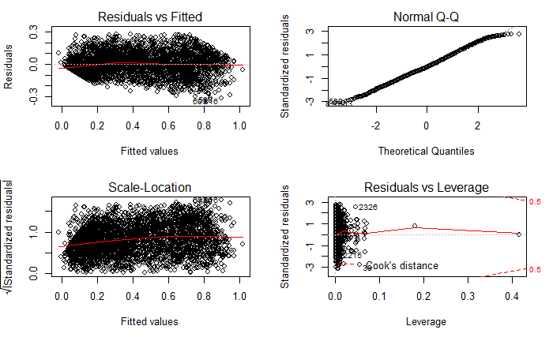
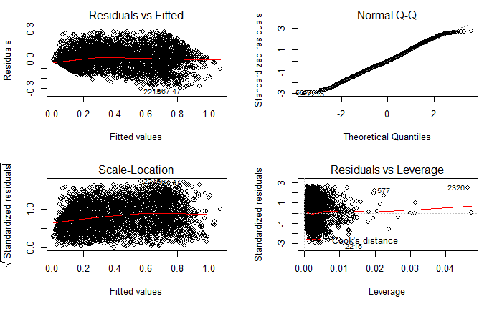
Compare lm.fit5 and lm.fit6
Adjusted R-squared: 0.861
Adjusted R-squared: 0.8578
plot(lm.fit5)
plot(lm.fit6)

Slide 21
LM: Delete Intercept——lm.fit7
lm.fit7=lm(winPlacePerc ~ boosts + damageDealt + walkDistance + weaponsAcquired +
I(maxPlace^2) + I(numGroups^2) + I(walkDistance^2) + I(weaponsAcquired^2) - 1)
R-squared: Adjusted R-squared:
0.956 0.956

Slide 22
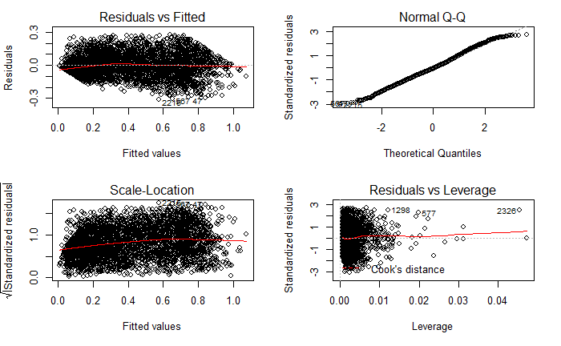
plot(lm.fit7)

Slide 23
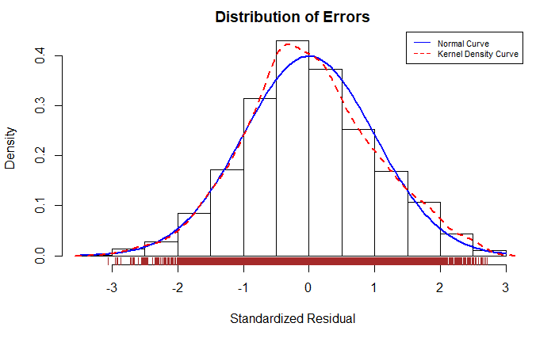
residplot(lm.fit7)

Slide 24
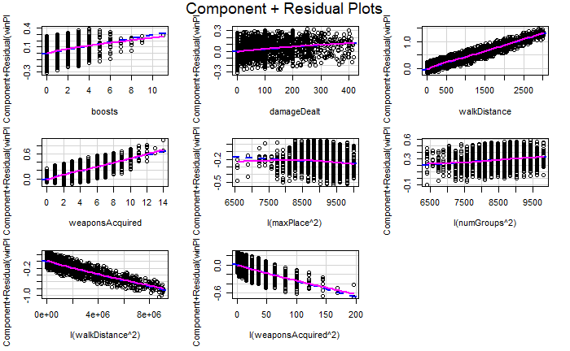
crplot(lm.fit7)

Slide 25
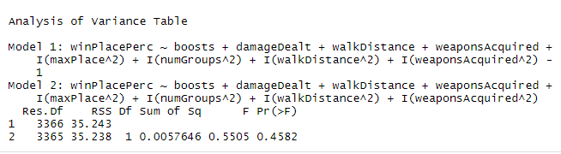
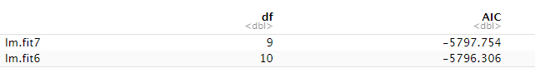
Compare lm.fit6 and lm.fit7
anova(lm.fit7,lm.fit6)
AIC(lm.fit7,lm.fit6)

Slide 26
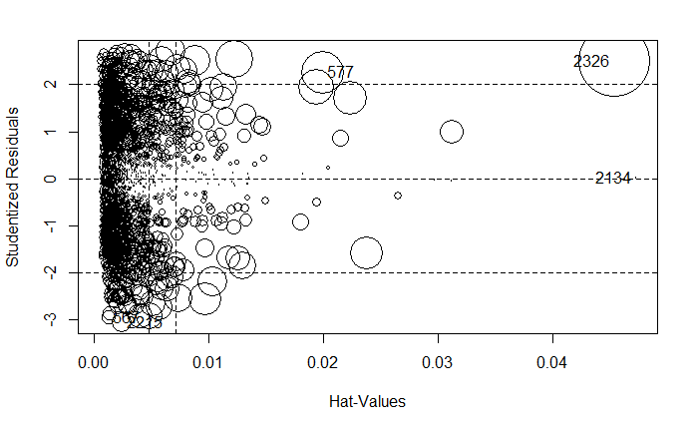
outlierTest(lm.fit7)
## No Studentized residuals with Bonferroni p < 0.05
## Largest |rstudent|:
## rstudent unadjusted p-value Bonferroni p
## 2215 -3.063882 0.0022022 NA
influencePlot(lm.fit7)

Slide 27
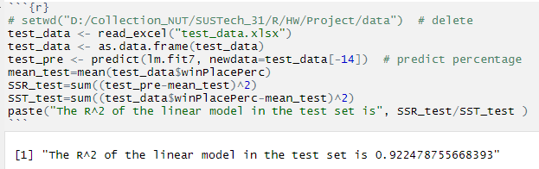
Predict
Validation Data Size: 1000
Testing R^2: 0.922
Notes:
这个线性模型是我们最简单的模型，只起到抛砖引玉的作用。线性模型手动删除因变量解决共线性问题，接下来让我们组员带来可以自动解决共线性的PCA模型。

Slide 28
Model Building and Selection PCA, Lasso, Ridge

Slide 29
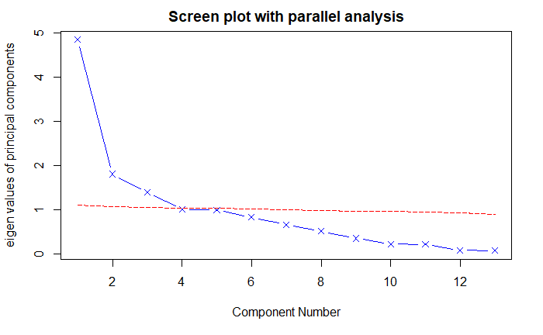

Slide 30
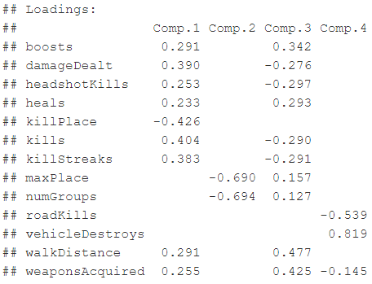

Slide 31
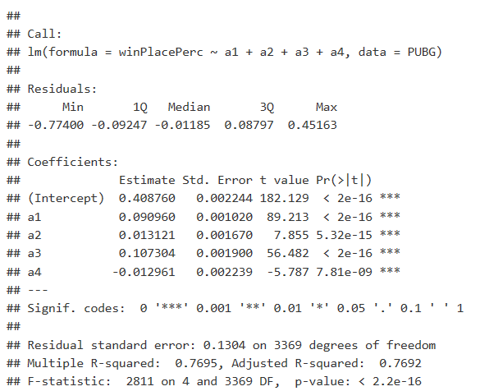
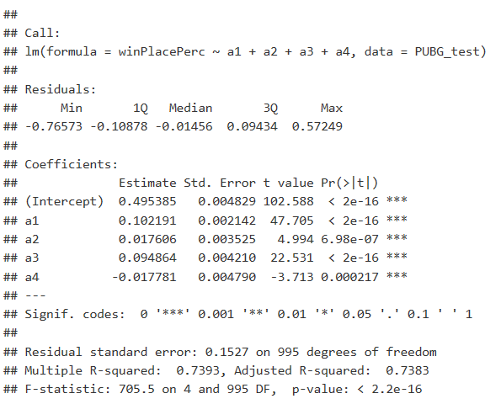
Training set:
Validation set:

Slide 32
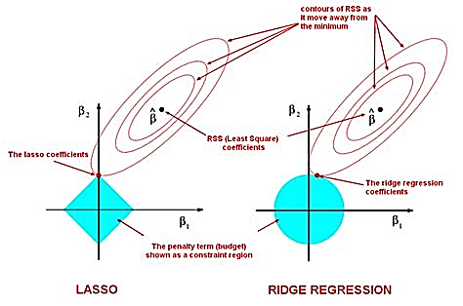
Lasso & Ridge Regression

Slide 33
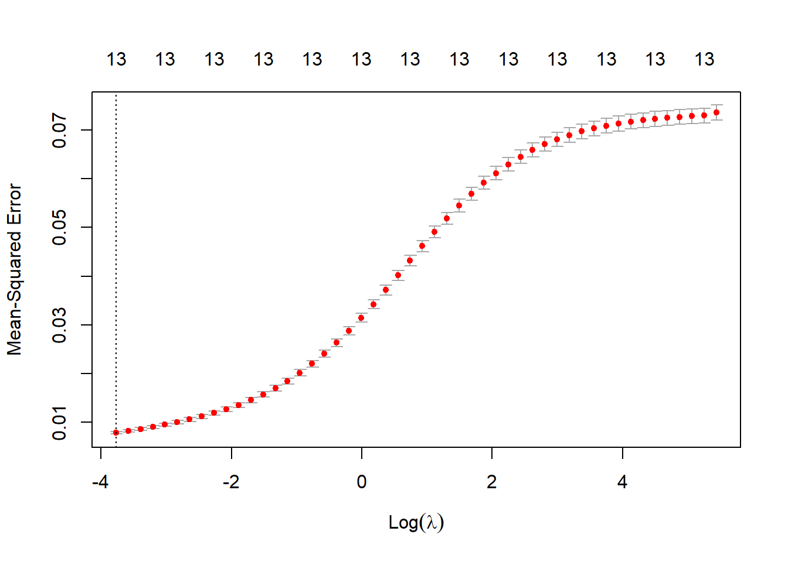
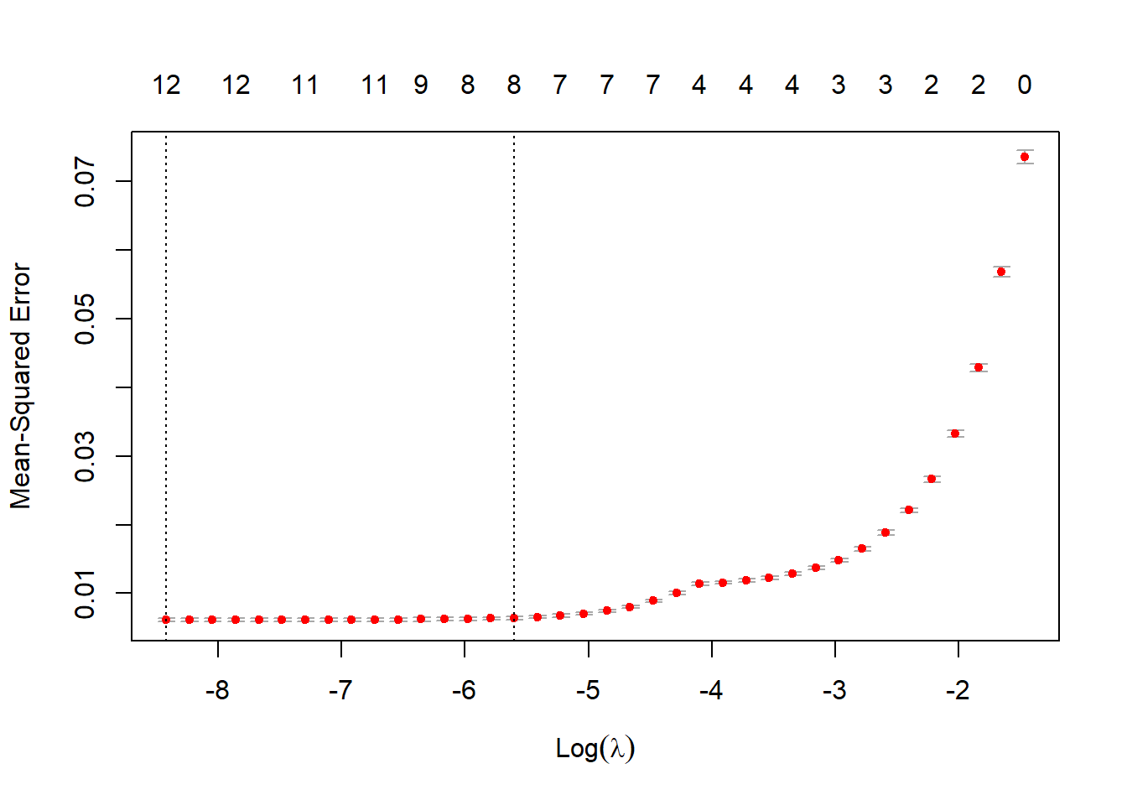
Ridge Regression:
Lasso Regression:

Slide 34
Model | Training set R^2 | Test set R^2
Ridge | 0.895 | 0.774
Lasso | 0.918 | 0.797

Slide 35
Model Building and Selection SVM, Neural Network

Slide 36
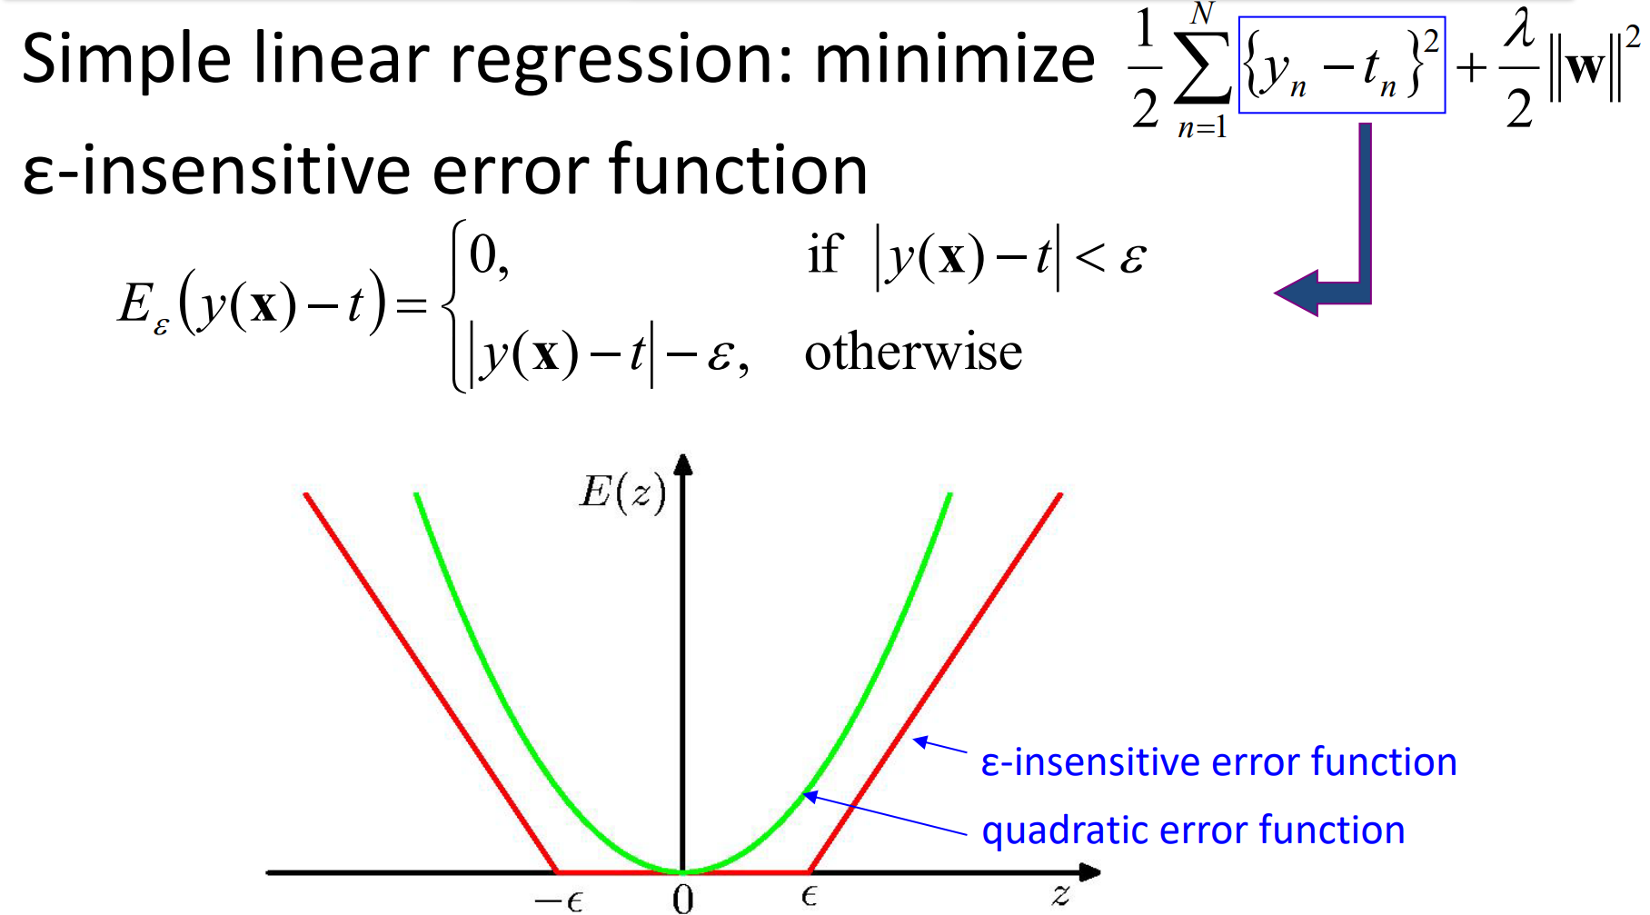
SVM: Formulation 1

Slide 37
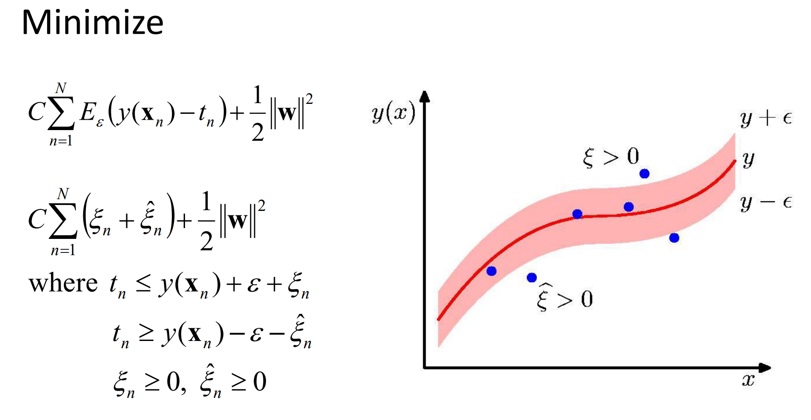
SVM: Formulation 2

Slide 38
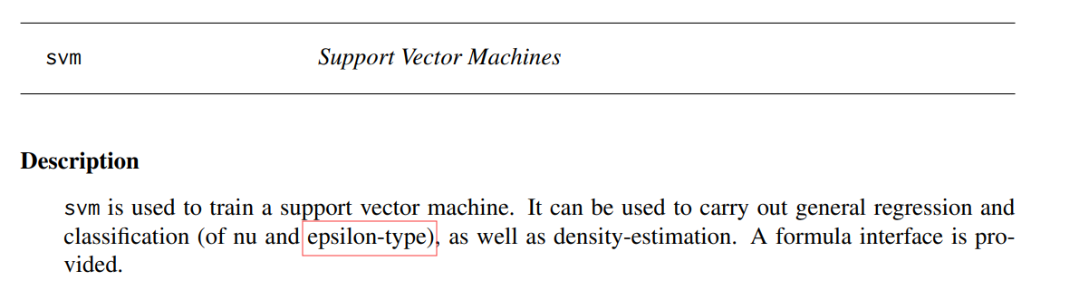
SVM: Implement 1
Use package ‘e1071’

Slide 39
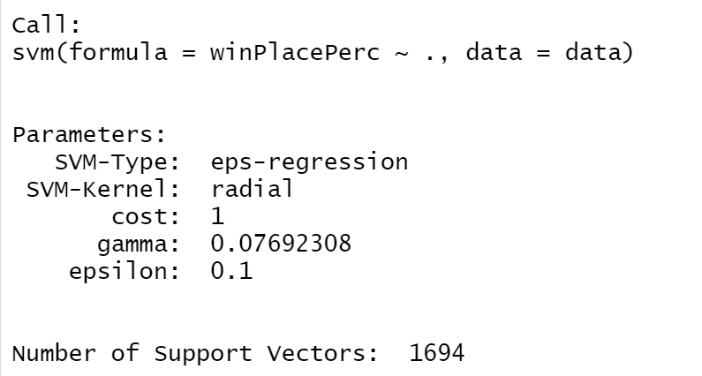
SVM: Implement 2
Parameters of SVM-models usually must be tuned to yield sensible results!

Slide 40
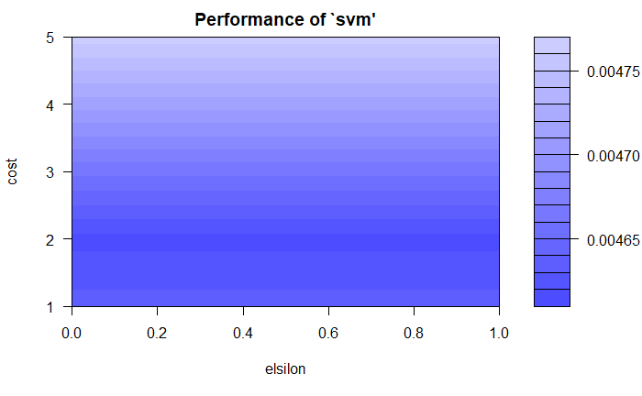
SVM: Tuning SVM model by CV

Slide 41
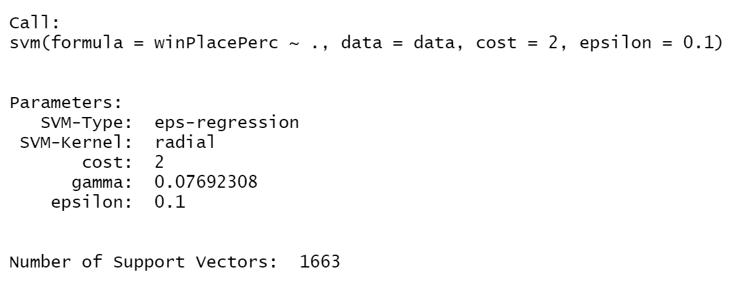
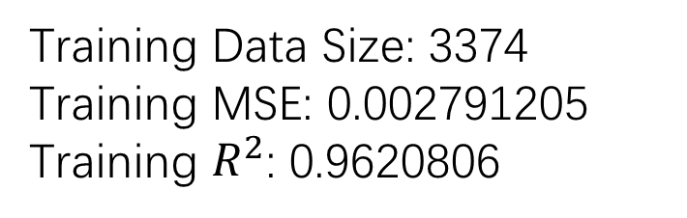
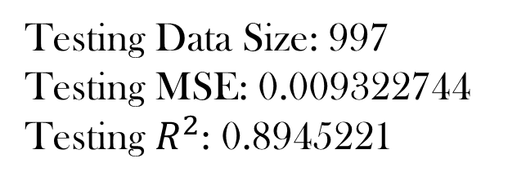
SVM: Finalized Model
Training Data Size: 3374
Training MSE: 0.002791205
Training $R^{2}$: 0.9620806
Testing Data Size: 997
Testing MSE: 0.009322744
Testing $R^{2}$: 0.8945221

Slide 42
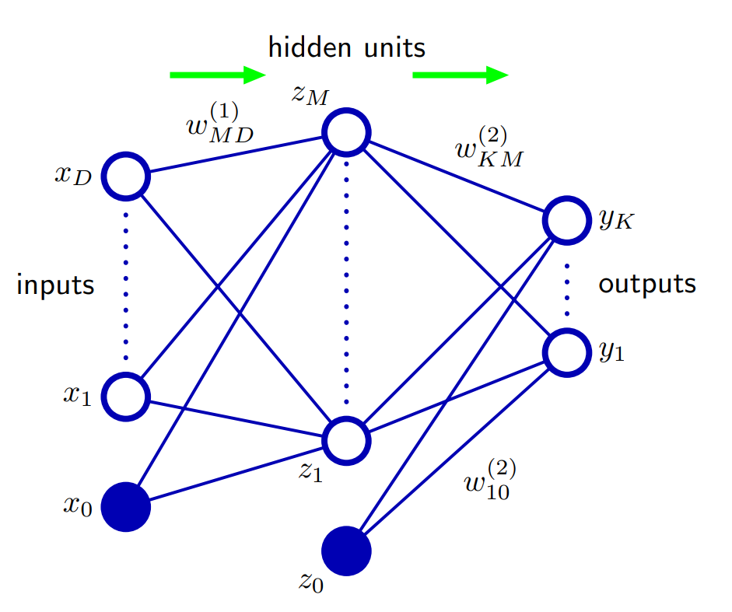
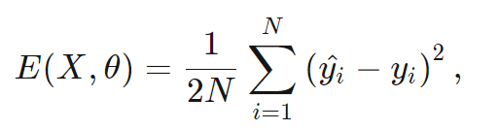
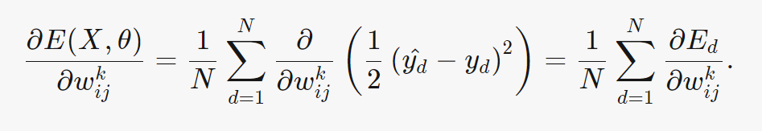
NN: Diagram

Slide 43
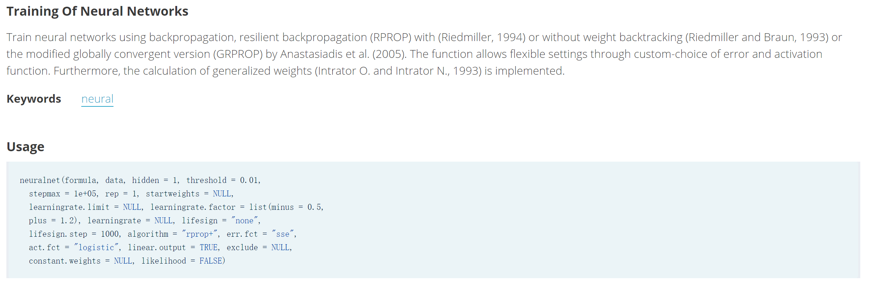
NN: Implement
We use “neuralnet” package

Slide 44
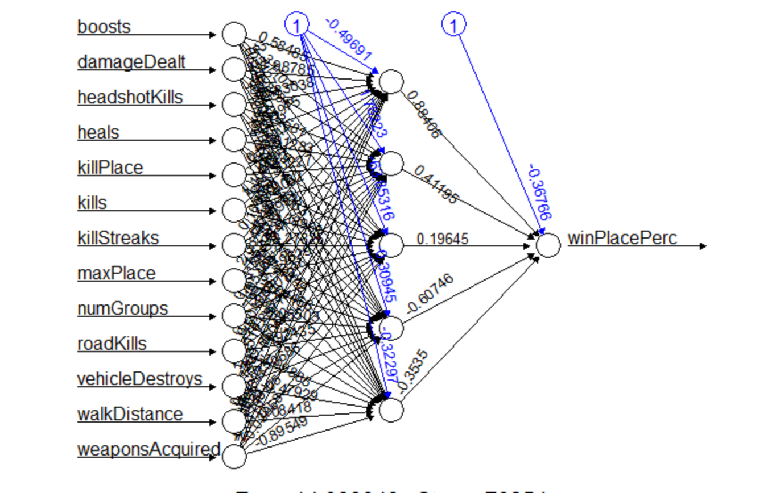
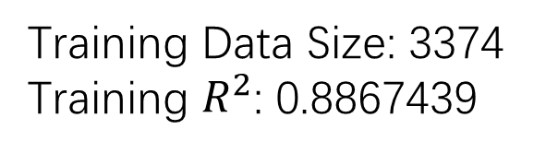
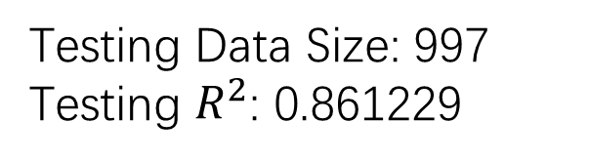
NN: Finalized Model
Training Data Size: 3374
Training $R^{2}$: 0.8867439
Testing Data Size: 997
Testing $R^{2}$: 0.861229

Slide 45
Model Building and Selection KNN, Regression Learner

Slide 46
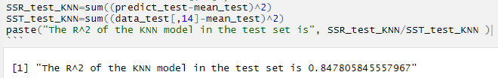
K N N
Euclidean Distance
Scale
Order
Prediction
N | 10 | 20 | 30 | 40 | 50
R^2 | 0.821 | 0.792 | 0.772 | 0.756 | 0.743
N | 60 | 70 | 80 | 90 | 100
R^2 | 0.731 | 0.721 | 0.711 | 0.702 | 0.694

Slide 47
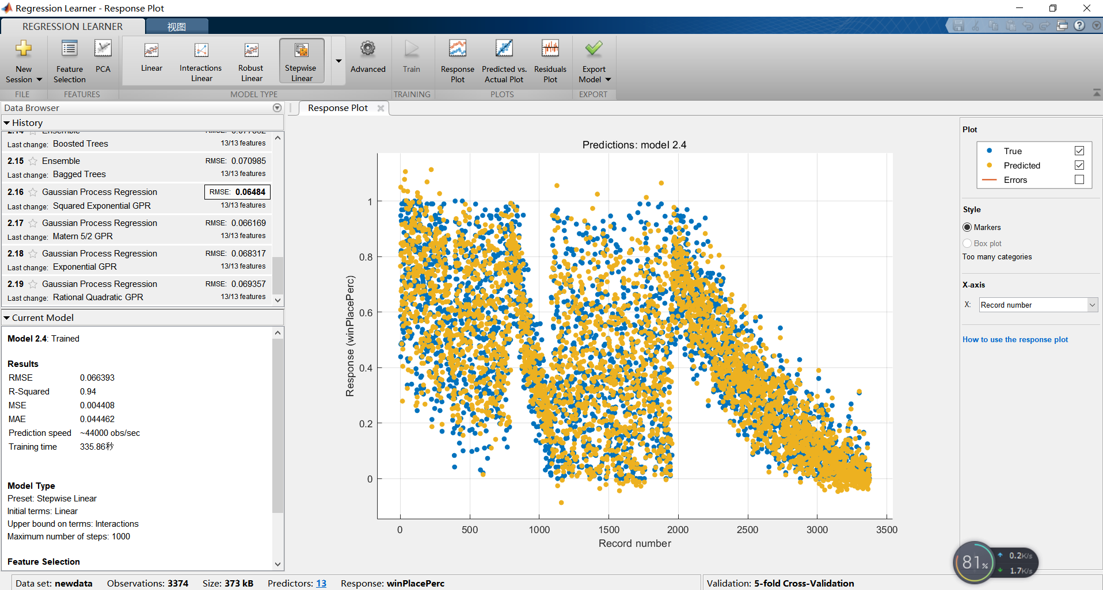
Regression Learner

Slide 48
Model Comparison

Slide 49
Model Comparison
Model | LS | PCA | Lasso | Ridge | KNN | SVM | Neural Network
R^2 (training) | 0.956 | 0.769 | 0.918 | 0.895 | 0.821 | 0.962 | 0.887
R^2 (testing) | 0.922 | 0.739 | 0.797 | 0.774 | 0.848 | 0.894 | 0.861

Slide 50

What's the best strategy to win in PUBG?
lm.fit7=lm(winPlacePerc ~ boosts + damageDealt + walkDistance +
weaponsAcquired + I(maxPlace^2) + I(numGroups^2) +
I(walkDistance^2) + I(weaponsAcquired^2) - 1)
Run More！
Keep Calm！
Obtain Weapons！

Slide 51



